Slide 1
Heart Disease Prediction
Team members:
Subhankar Pati RA1911031010063
Akarshit Vats RA1911031010066
Sreyansh Sachan RA1911031010070

Slide 2
Problem statement
The major challenge in heart disease is its detection. There are instruments available which can predict heart disease but either it are expensive or are not efficient to calculate chance of heart disease in human. Early detection of cardiac diseases can decrease the mortality rate and overall complications. However, it is not possible to monitor patients everyday in all cases accurately and consultation of a patient for 24 hours by a doctor is not available since it requires more sapience, time and expertise. Since we have a good amount of data in today’s world, we can use various machine learning algorithms to analyze the data for hidden patterns. The hidden patterns can be used for health diagnosis in medicinal data.

Slide 3
Motivation
The main motivation of doing this project is to present a heart disease prediction model for the prediction of occurrence of heart disease. Further, this project work is aimed towards identifying the best classification algorithm for identifying the possibility of heart disease in a patient. This work is justified by performing a comparative study and analysis which are used at different levels of evaluations. Although these are commonly used machine learning algorithms, the heart disease prediction is a vital task involving highest possible accuracy. Hence, the algorithms are evaluated at numerous levels and types of evaluation strategies.This will provide researchers and medical practitioners to establish a better.

Slide 4
Details about the data set
This data set dates from 1988 and consists of four databases: Cleveland, Hungary, Switzerland, and Long Beach V. It contains 76 attributes, including the predicted attribute, but all published experiments refer to using a subset of 14 of them. The dataset is based on the points of the ECG graph.The "target" field refers to the presence of heart disease in the patient. It is integer valued 0 = no disease and 1 = disease. Attribute Information: age, sex , chest pain type (4 values), resting blood pressure, serum cholestoral in mg/dl, fasting blood sugar > 120 mg/dl, resting electrocardiographic results (values 0,1,2), maximum heart rate achieved, exercise induced angina, oldpeak = ST depression induced by exercise relative to rest, the slope of the peak exercise ST segment, number of major vessels (0-3) colored by flourosopy, thal: 0 = normal; 1 = fixed defect; 2 = reversable defect. The names and social security numbers of the patients were recently removed from the database, replaced with dummy values. The data set is in csv (Comma Separated Value) format which is further prepared to data frame as supported by pandas library in python.

Slide 5
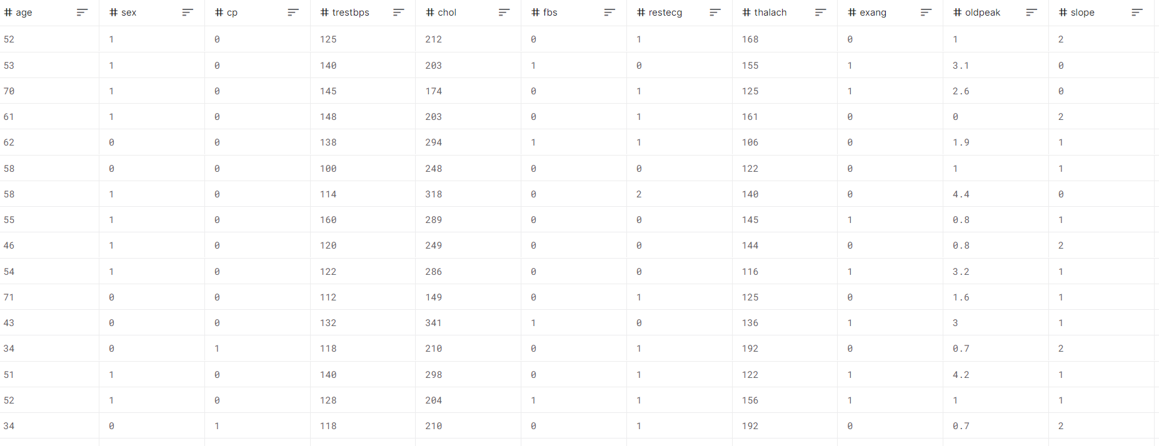

Slide 6
Pre-processing
Data preprocessing is an important step for the creation of a machine learning model. Initially, data may not be clean or in the required format for the model which can cause misleading outcomes. In pre-processing of data, we transform data into our required format. It is used to deal with noises, duplicates, and missing values of the dataset. Data pre-processing has the activities like importing datasets, splitting datasets, attribute scaling, etc. Preprocessing of data is required for improving the accuracy of the model.

Slide 7
Algorithm used
Logistic regression is basically a supervised classification algorithm. In a classification problem, the target variable(or output), y, can take only discrete values for a given set of features(or inputs), X. Contrary to popular belief, logistic regression IS a regression model. The model builds a regression model to predict the probability that a given data entry belongs to the category numbered as “1”. Just like Linear regression assumes that the data follows a linear function, Logistic regression models the data using the sigmoid function.
Logistic regression becomes a classification technique only when a decision threshold is brought into the picture. The setting of the threshold value is a very important aspect of Logistic regression and is dependent on the classification problem itself.
In logistic regression, we generally compute the probability which lies between the interval 0 and 1 (inclusive of both). Then probability can be used to classify the data. For example, if the computed probability comes out to be greater than 0.5, then the data belonged to class A and otherwise, for less than 0.5, the data belonged to class B.

Slide 8
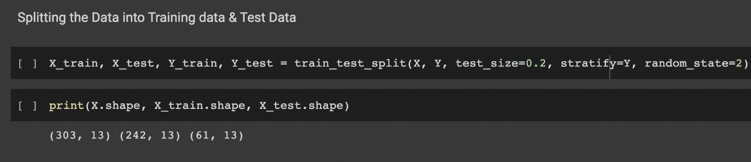
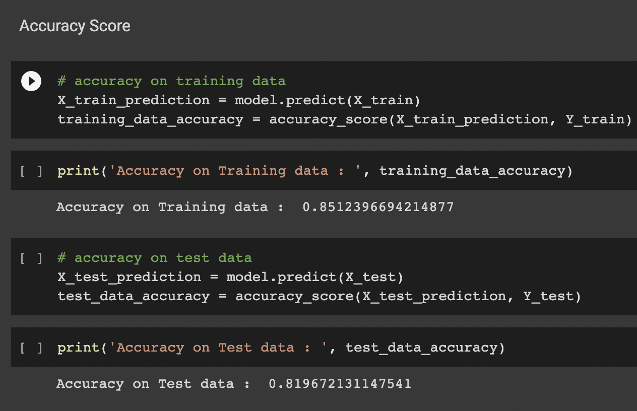
Training and testing
We split the data into sets of training and testing.
We split it into 2 sets one set for testing and the other set for training the ML.

Slide 9
Performance measures
In the logistic regression model we predict the accuracy of the test data. After finding the accuracy in the dataset and resolving any overfitting issue, we build a predictive system.
So in this system if we give the all the feature values then the model will predict the target i.e. if the person is having defective heart or not.

Slide 10
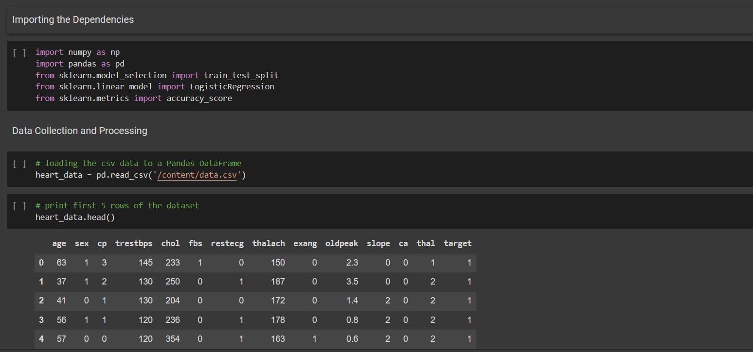
Code snippet

Slide 11
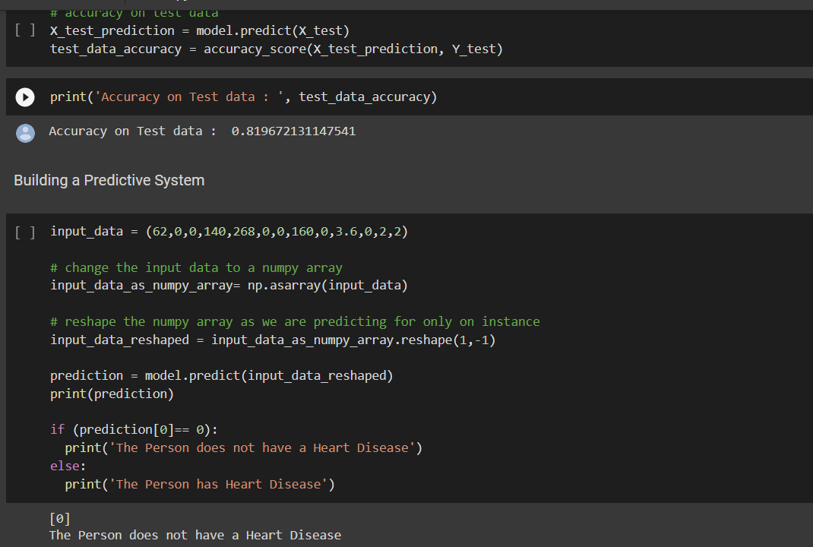
Output

Slide 12
References
http://ictactjournals.in/paper/IJSC_Vol_9_Iss_1_Paper_6_1817_1823.pdf
http://cse.anits.edu.in/projects/projects2021C3.pdf
https://colab.research.google.com/drive/1FYGPRSEGvd0urNlZmRJHx-gq6ANn3IpX?usp=sharing

